Slide 1


File System API and Disk I/O
SE3331-1 (2022 Fall)
IPADS, Shanghai Jiao Tong University
https://www.sjtu.edu.cn

Slide 2
Review: Large-scale websites on distributed systems
While distributed systems are built from components on a single node
File system runtimes, etc.
Caching server
Caching server
Caching server
…
Caching
Caching
Caching
Distributed caching
Database server
Database server
CDN
Users
Application #1
generate the page
Database
user, price
…
Database
user, price
Application server
Distributed database
Internet
Load
Balance
Application #2
add the order
File server
File server
File server
File:
image
File:
image
…
File:
image
Application server
…
…
Message queue
Distributed file system

Slide 3
Review: Large-scale websites on distributed systems
While distributed systems are built from components on a single node
File system runtimes, etc.
Caching server
Caching server
Caching server
…
Caching
Caching
Caching
Distributed caching
Database server
Database server
CDN
Users
Application #1
generate the page
Database
user, price
…
Database
user, price
Application server
Distributed database
Internet
Load
Balance
Application #2
add the order
File server
File server
File server
File:
image
File:
image
…
File:
image
Application server
…
…
Message queue
Distributed file system

Slide 4
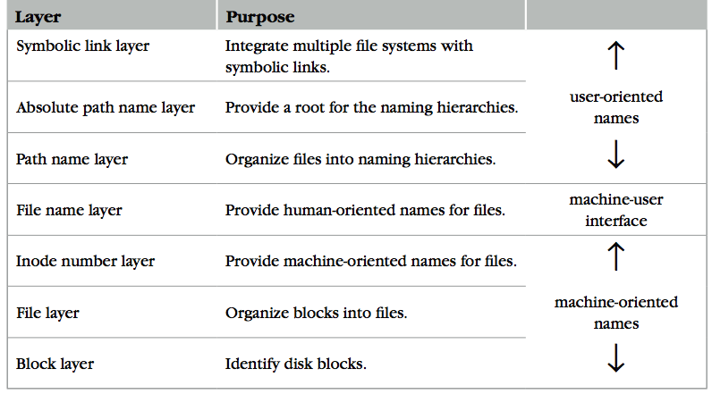
Review: The Naming Layers of the UNIX FS (version 6)
Notes:
TODO: redraw

Slide 5
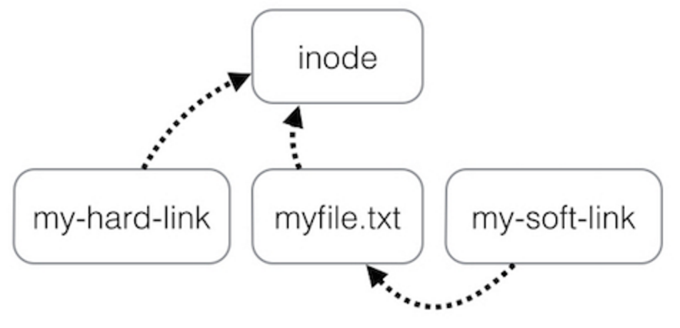
Review: Two Types of Links (Synonyms)
这里补充为何需要一个fileNameLayer：若没有单独的fileNameLayer，那就会直接使用inodeNum作为文件名的声明，但是这样会将文件名这个标识符与对应inode在磁盘上的位置绑定，这就会导致，当inode位置修改，比如更换文件系统等，文件可能需要重新命名。这样对于用户而言是不好的。而加了一个nameLayer之后，则会将文件标识符自身放在单独一层，使其与inodeNum解耦
By inode number
By inode number
通过此图可以知道，做了hard link的文件
是直接映射到inode的，所以其存储的内容就
应该是inode中的实际文件内容。做了symbolic link的
文件其是映射到另外一个文件名上面的，所以其对应
文件内存储的应该是被其映射到的那个文件的路径。
所以文件显示的内容就是对于“映射”的反应
By file name

Slide 6
Summary of File System's 7 Layers
Name is data of a dir:目录中存储的是一系列的文件名与inode num的键值对
File name is not part of a file
Name is not a part of an inode
Name is data of a directory, and metadata of a file system
One inode can have several names (hard links)
Hard links are equal
If a file has two names, both are links (instead of "a link and a name")
Directory size is small
Only mapping from name to inode number
The term "folder" is somewhat misleading
而fileName不是文件的元数据，因为他不是inode的
一部分。
这里的equal是在说hard-links是不分先后的

Slide 7
Implementing the file system API

Slide 8
Implementing the File System API
API
CHDIR, MKDIR
CREAT, LINK, UNLINK, RENAME
SYMLINK
MOUNT, UNMOUNT
OPEN, READ, WRITE, APPEND, CLOSE
SYNC
Implemented as system calls to user applications
Kernel has many sets of function pointers implementing the API
Each set is specific to a FS (chose at mount point)

Slide 9
Sidebar: open() vs. fopen()
Difference between open() and fopen()?
open() returns an fd; fopen() return a FILE*
open() is a system call of OS; fopen() is an API of libc(被封装过)
Questions
Which one can be used on both Windows and Linux?
Which one has better performance?
fopen() provides you with buffering I/O that may turn out to be a lot faster than what you're doing with open()
Notes:
What is the difference between FILE* and fd? Fopen and open?

Slide 10
File Meta-data -- inode
注意：ctime指的是对于inode的修改，如添加
新的LINK，分配了新的block给这个inode，删除了
一个LINK等，而mtime指的是通过WRITE等syscall
来修改了文件block中的具体内容
Owner ID
User ID and group ID that own this inode (can be changed by chown)
Types of permission
Owner, group, other
Read, write, execute
Time stamps
Last access (by READ)(atime)
Last modification (by WRITE)(mtime)
Last change of inode (by LINK)(ctime)
struct inode
integer block_nums[N]
integer size
integer type
integer refcnt
integer userid
integer groupid
integer mode
integer atime
integer mtime
integer ctime
Notes:
There are three more mode bits: setuid, setgid, stick_bit

Slide 11
OPEN a File
如何检查user’s permission？
首先在尝试打开文件时操作系统会将当前进程的userId(来自于父进程)与对应的操作的文件存储的userId(来自于inode)作比较，来确定该用户是否具有使用权限，并会检查文件mode来检查具体的使用权限。
Check user's permission
Update last access time
Return a short name for a file
File descriptor (fd)
fd is used by READ, WRITE, CLOSE, etc.

Slide 12
File Descriptor
Each process starts with three default open files
Standard in(stdin): fd = 0, standard out(stdout): fd = 1, standard error(stderr): fd = 2
Can also use fd to name opened devices
Keyboard, display, etc.
Allow a designer not to worry about input/output
Just read from fd 0 and write to fd 1
Each process has its own fd name space(每个进程有自己的fd-table)
外部链接设备也会被抽象为文件，
但是其对应数据并不对应于某一个
磁盘blocks；同时，并不是所有
devices对应的文件都一定可读可写
，如键盘。
Notes:
What is the different between fd and inode?
More details on device as a file

Slide 13
Why File Descriptor?
Other options
Option-1: OS returns an inode pointer(不安全)
Option-2: OS returns all the block numbers of the file
Reasons and considerations
Security: user can never access kernel's data structure
Non-bypassability: all file operations are done by the kernel
Aka., complete mediation(完全中介)
指的是任何对于文件的操作都不能绕过kernel去执行。

Slide 14
File Cursor
File cursor
Keep track of operation position within a file
Can be changed by the SEEK operation
Case-1: Sharing file cursor
Parent passes its fd to its child
In UNIX, a child process inherits all open fds from its parent
Allow both parent and child to share one output file
Case-2: Not sharing file cursor
Two processes open the same file
Cursor

Slide 15
fd_table & file_table
One file_table for the whole system
Records information for opened files
inode num, file cursor, ref_count of opening processes
Children can share the cursor with their parent
One fd_table for each process
Records mapping of fd to index of the file_table
要注意file_table中的ref_count与inode中存储的ref_count的区别。inode中的ref_count
指的是与这个inode做了LINK的文件个数，file_table中的ref_count指的是一个文件被
不同process打开的次数。

Slide 16
File Cursor Sharing
Note: this refcnt is not the refcnt of inode!
fd-table与file-table
数据只在opened文件
中存在，且为in-memory
fd_table
file_table
fd
index
index
inode num
file cursor
refcnt
Process A
3
115
115
23
128
1
116
23
240
2
fd
index
Process B
3
116
...
fd
index
C is B's child
3
116
Process A, B and C all open just one file with inode number 23
Process A and B open the same file, not share file cursor
Process B and C share the file cursor

Slide 17
OPEN Implementation
procedure OPEN(string filename, integer flags, integer mod)-> integer
0 inode_number ← PATH_TO_INODE_NUMBER(filename, wd)
if inode_number = FAILURE and flags = O_CREATE then // Create the file?
inode_number ← CREATE(filename, mode) // Yes, create it.
if inode_number = FAILURE then
return FAILURE
inode ← INODE_NUMBER_TO_INODE(inode_number)
if PERMITTED(inode, flags) then // Does this user have the required permissions?
file_index ← INSERT(file_table, inode_number)
fd <- FIND_UNUSED_ENTRY(fd_table) // Find entry in file descriptor table
fd_table[fd] ← file_index // Record file index for file descriptor
return fd // Return fd
else return FAILURE // No, return a failure

Slide 18
READ Implementation
procedure READ(integer fd, character[] &buf, integer n)-> integer
0 file_index ← fd_table[fd]
cursor ← file_table[file_index].cursor
inode ← INODE_NUMBER_TO_INODE(file_table[file_index].inode_number)
m ← MINIMUM(inode.size – cursor, n)
atime of inode ← now()
if m = 0 then return END_OF_FILE
for i from 0 to m – 1 do
b ← INODE_NUMBER_TO_BLOCK(cursor + i, inode_number)
COPY(b, buf, MINIMUM(m-i, BLOCKSIZE)
i ← i + MINIMUM(m – i, BLOCKSIZE)
file_table[file_index].cursor ← cursor + m
return m
对于这里的inode文件系统，size剩余大小
是判断文件是否全部读完的依据。

Slide 19
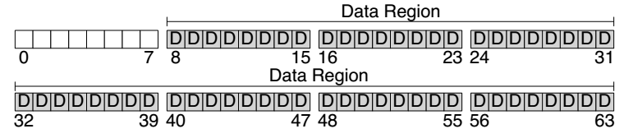
Disk Layout of a Simple File System

Slide 20
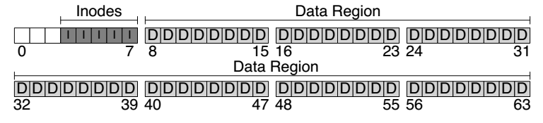
At the Head of a Disk Partition
S
i
d
i: inode free block bitmap
d: data free block bitmap
S: super-block
How many inodes: 80
How many data blocks: 56
Where the inode table begins: block 3
…
A magic number to identify the file system type
The super-block is used when
the file system is mounted

Slide 21
Questions
How many read and write in a OPEN?
How many read and write in a READ?
How many read and write in a CREATION?
对于第23页PPT的Note：为何要在对于bar的write之前做一次read？
因为对于bar的write是最终需要写到磁盘上面的，而inode与一个FS block的大小比例一般为
1:4，即一个inode为1k左右大小，而文件系统为了防止出现对于已有数据的覆盖情况，需要
先将目标的block读取上来(注意block是文件系统从disk读取内容的最小单位)，将对应inode
内容修改之后再写回。

Slide 22
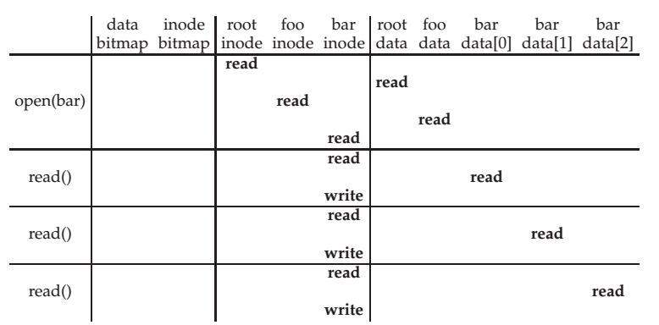
File Open & Read Timeline
下方问题解答：在bar inode的read之后进行的write
实际上是修改的是对应inode的access time(atime)，
即使这个bar文件权限为”只读”，上述操作也会进行。
而为何对于foo inode的访问不需要write?因为对于
目录的访问不需要记录access time。
注意：”/”并不根目录本身，只是一个分隔符号，
“root”目录本身名称是一个空串!
open("/foo/bar", O_RDONLY)
到第五行为之bar文件成功打开了
Why "write" on bar inode in a read operation? Why no "write" on foo inodes?

Slide 23
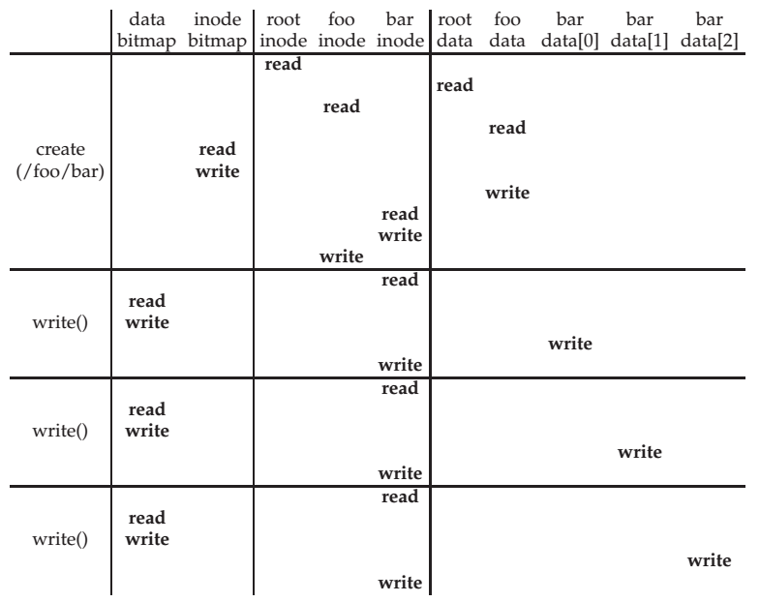
File Creation Timeline
inode bitmap
处的read/write
是在查找一个
未被使用的inode
的number。
write()的时候对于data-bitmap的read与write是要在block装不下的时候去寻找新的block

Slide 24
WRITE, APPEND & CLOSE
WRITE is similar to READ
Allocate new block if necessary
Update inode's size and mtime
APPEND
Similar to write, directly write to the end of the file
CLOSE
Free the entry in the fd_table
Decrease the reference counter in file table
Free the entry in file table if counter is 0
Failures in the middle may cause inconsistency!
但是WRITE操作修改之后记得要把
新的相关信息写回inode。

Slide 25
Questions
选择第一项
When writing, which order is preferred?
Update block bitmap, write new data, update inode (size and pointer)
Update block bitmap, update inode (size and pointer), write new data
Update inode (size and pointer), update block bitmap, write new data
为何最后才能update inode：因为前面的PPT提到，文件的整体读取时读取的字节数
是取决于此时的size的数值。(即使是部分读取，也会受到size影响)其实对于正常情况而言，上述三个过程顺序不会对结果产生影响。但是关键问题是发生crash时。如，在write new data之后，update之前发生了crash，如果是先crash，在update(但是不会发生了)，那么在重启之后在读取这个文件不会由于size变大了但是对应的数据内容范围没有变化而出现读取错误内容的问题。因为并不能保证新分配的空间之前没有被使用过。所以如果顺序出错，可能会错误的读取到一些文件已经被删除但是对应的inode未被清空的一些不该被读取的数据。
但是先进行block的分配也是有问题的。如果在分配block之后write之前发生crash，则会出现
disk上空间被浪费的情况，因为刚被分配的block还未被inode存储就crash了，对于这个文件本身，他再看不到这个block的内容，对于其他文件，想用这个block却发现已经bitmap值为1，也不能使用了，所以就浪费了。

Slide 26
SYNC
Block cache
Cache of recently used disk blocks
Read from disk if cache miss
Delay the writes for batching
Improve performance
Problem: may cause inconsistency if fail before write
SYNC
Ensure all changes to a file have been written to the storage device

Slide 27
Delete after OPEN but before CLOSE
One process has OPENed a file
Another process delete the same file
By removing the last name pointing to the file
The reference counter is now 0
The inode is not freed until the first process calls CLOSE
On Windows, it may forbid to delete an opened file
具体逻辑是，在一个进程open一个文件但是该文件同时被另外进程delete时，
在目录下已经找不到这个文件了，但是对应的inode未被删除，因为虽然此时
此文件ref_count为0，但是open的那个进程在未关闭时，这部分资源是未释放
的，所以inode不会被删除。(在UNIX下，并且前提是需要时stateful的)

Slide 28
Review: Renaming
1 UNLINK(to_name)
2 LINK(from_name, to_name)
3 UNLINK(from_name)
❌
Text edit usually save editing file in a temp file
Edit in .a.txt.swp, then rename .a.txt.swp to a.txt
What if the computer fails between 1 & 2?
The file to_name will be lost, which will surprise the user
Need atomic action (in later lectures)

Slide 29
Review: Renaming
1 LINK(from_name, to_name)
2 UNLINK(from_name)
Weaker specification without atomic actions
1. Changes the inode # for to_name to the inode # of from_name
2. Removes the directory entry for from_name
If fails between 1 & 2
Must increase reference count of from_name's inode on recovery
If to_name already exists
The to_name file will always exist, even if the machine fails between 1 & 2
Need to revoke the resource on recovery

Slide 30
Rename between different directories
$ ls -il dir1
40978804 -rw-r--r-- 1 xiayubin wheel 6 9 26 08:50 from.txt
$ ls -il dir2
40978827 -rw-r--r-- 1 xiayubin wheel 7 9 26 08:51 to.txt
$ mv dir1/from.txt dir2/to.txt
$ ls dir1
$ ls -il dir2
40978804 -rw-r--r-- 1 xiayubin wheel 6 9 26 08:50 to.txt
inode number

Slide 31
Renaming
1 UNLINK(to.txt)
2 LINK(from.txt, to.txt)
3 UNLINK(from.txt)
1 LINK(from.txt, to.txt)
2 UNLINK(from.txt)
If to.txt exists and fails between 1 & 2
The file to.txt will be lost,
which will surprise the user
If to.txt exists and fails between 1 & 2
It will always exist even if the machine fails between 1 & 2
Must increase reference count of from.txt's inode on recovery

Slide 32
Other file systems (not inode)

Slide 33
Other Choices instead of inode
Method-1: use continue blocks
Re-allocate if the file expands
E.g., data in memory
Why not?
Method-2: use a linked list
Each block links to its next block
Use special one as EOF (End of File)
E.g., FAT32
Why not?
How to integrate different FS?
vnode (will discuss later)
Interface is similar with inode

Slide 34
FAT (File Allocation Table) File System
File is a collection of disk blocks
FAT is a linked list 1-1 with blocks
File Number is index of root of block list for the file
File offset (o = < B, x > )
Follow list to get block #
Unused blocks ⬄ FAT free list
FAT
Disk Blocks
file number
0:
0:
31:
File 31, Block 0
File 31, Block 1
free
File 31, Block 2
N-1:
N-1:
memory

Slide 35
FAT Properties
File is a collection of disk blocks
FAT is a linked list 1-1 with blocks
File Number is index of root of block list for the file
File offset (o = < B, x > )
Follow list to get block #
Unused blocks ⬄ FAT free list
Ex: file_write(31, < 3, y >)
Grab blocks from free list
Linking them into file
FAT
Disk Blocks
file number
0:
0:
31:
File 31, Block 0
File 31, Block 1
File 31, Block 3
free
File 31, Block 2
N-1:
N-1:
memory

Slide 36
FAT File System
FAT#2做备份
Boot Sector类似于super block
File allocation table (FAT)
Organize files as linked lists
No inode
File metadata: name & size
Metadata are saved in dirs
实现简单，但是block使用链表传输，
遍历慢，插入还要先查找，慢，更适用于
文件的传输。如图片和整块连续数据等。

Slide 37
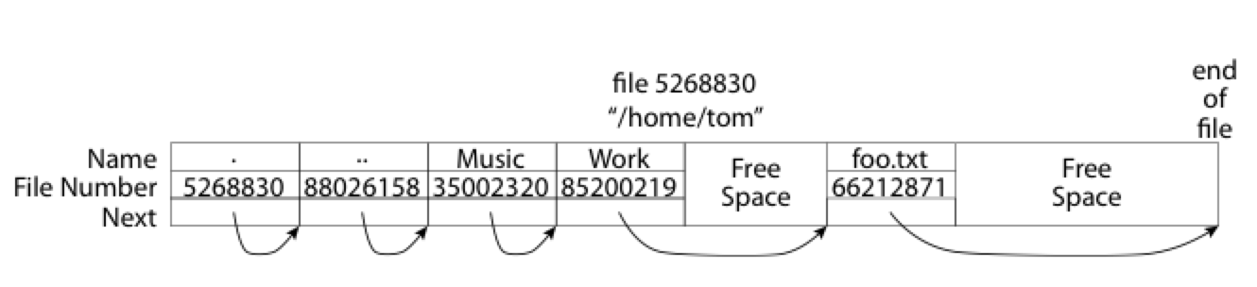
What about the Directory in FAT?
Directory: essentially a file containing <file_name: file_number> mappings
Free space for new entries
File attributes (metadata) are kept in directory
Each directory is a linked list of entries
Question: Where to find root directory ( "/" )?
Root dir at sector 0

Slide 38
Question: inode vs. FAT
What are the differences between inode and FAT?
Support hard link? Soft link?

